Slide 1
Chrome Extensions
https://developer.chrome.com/extensions
https://github.com/indefinitelee/presentation_extension

Slide 2
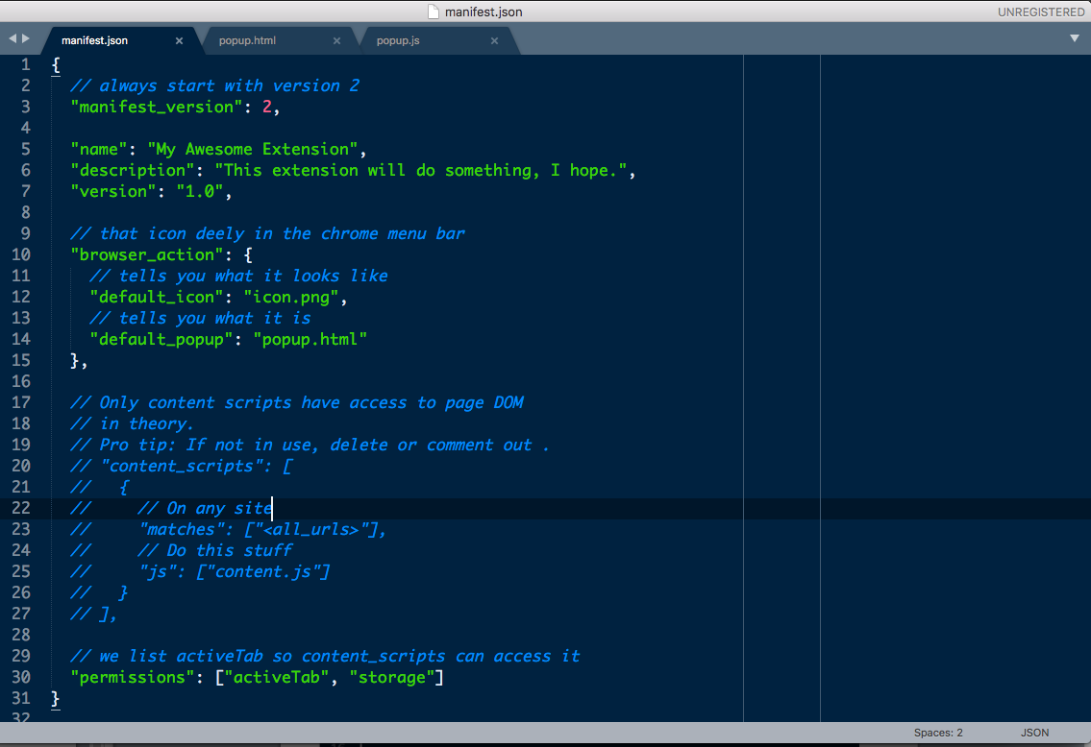
Manifest Boilerplate

Slide 3
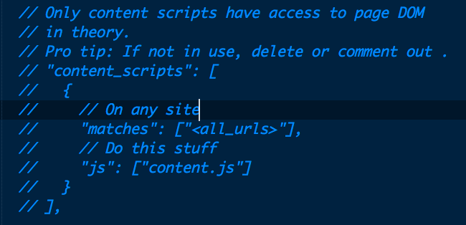
But you can also use the chrome.tabs.executeScript API to execute code written as a string
That fine print tho

Slide 4
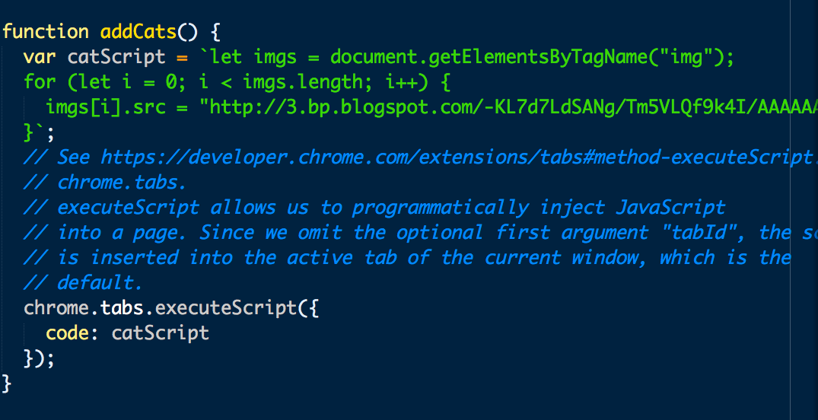
Using execute script to modify the DOM without use of content script

Slide 5
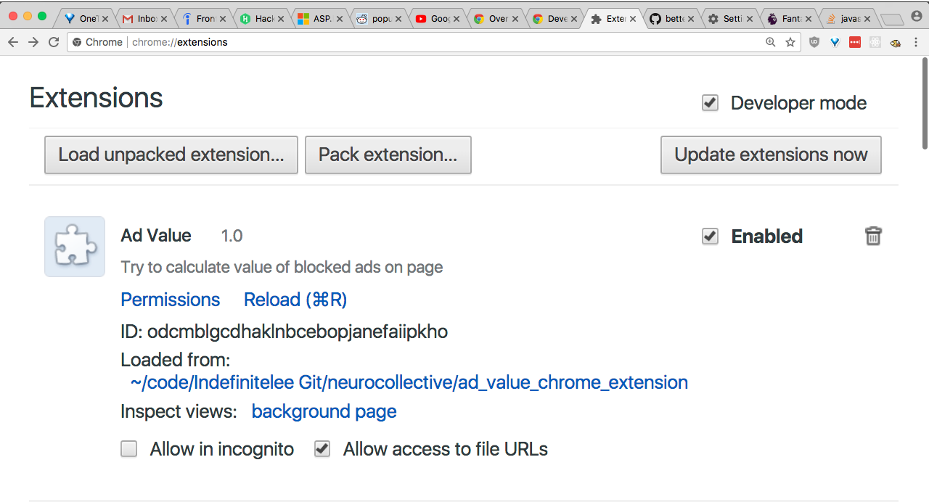
Reload your extension!!
Hit that Command R whenever you edit manifest.json

